Slide 1
3D Game programming
Project 3D Game Development
Developer: n.van.der.heide@pl.hanze.nl

Slide 2
3D Game programming
Plan
This week’s challenge
Working with Unity

Slide 3
Assignment a challenge with 4 steps
Introduce
Deconstruct
Reconstruct
Expand

Slide 4
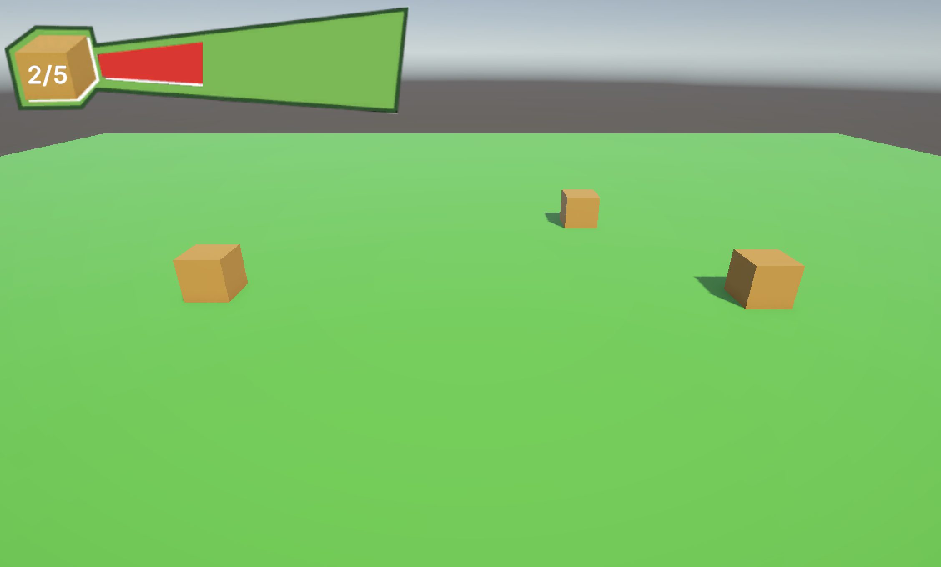
Step 1: Introduce introduction of the problem and demonstration of the end result
Create a scene with a plane and 5 boxes. If you click on a box it disappears and a bar fills up to show the box has been “collected”. Communication between a box and the UI should be with the help of an event. The UI should be built with UI Toolkit.

Slide 5
Step 2: Deconstruct deconstruct the problem into small sub-problems
“Create a scene with a plane and 5 boxes. If you click on a box it disappears and a bar fills up to show the box has been “collected”. Communication between a box and the UI should be with the help of an event. The UI should be built with UI Toolkit.”
Break the main problem down into smaller problems for you to solve.
Write these small sub-problems in a list.
Make sure to think about a logical order.
At the end of each step you have a functioning product that has part of the functionality implemented.
At the end of the last step you have a functioning product that solves the main problem.

Slide 6
Step 3: Reconstruct reconstruct the solution by solving the sub-problems
“Create a scene with a plane and 5 boxes. If you click on a box it disappears and a bar fills up to show the box has been “collected”. Communication between a box and the UI should be with the help of an event. The UI should be built with UI Toolkit.”
Solve the sub-problems from the list one at a time.
After solving a sub-problem you should have a working (read: error free) product with part of the functionality implemented.
Make sure to continue with the next sub-problem only when you finished the current one.
After solving the last sub-problem you should have reconstructed the solution shown in step one and you have solved the main problem.
Nice starting point: https://learn.unity.com/tutorial/make-health-bar-with-UItoolkit

Slide 7
Step 4: Expand how can you expand on this project?
Write down three ways in which you could expand on this project
Write down three ways how you could use the knowledge gained from this project in another project

Slide 8
Assignment working with Unity
Work on artifacts for your portfolio.
For example:
Expand on today’s challenge.
Use the knowledge from today’s challenge in a different context.
Work on your own project.
Work on features for the group project.

Slide 9
Homework what to work on before next week
Work on artifacts for your portfolio.
For example:
Expand on today’s challenge.
Use the knowledge from today’s challenge in a different context.
Work on your own project.
Work on features for the group project.

